Slide 1

the covid-19 pandemic &
the effect it had on streaming services
Allie Panacci

Slide 2

Allie Panacci
I am born and raised in Arizona, currently working and going to school full time. Starting in January 2023, I will be pursuing a Bachelor's degree in Statistics at Arizona State University. I have really found my place in the Data Science field, and it has given me a space to explore my passion for creativity, analysis, and technology.
Education:
Paradise Valley Community College
Associates - Applied Science
(Expected graduation date 2022)
Southern Careers Institute Inc Powered By Woz-U
Certification - Data Science
(2021-2022)
Links:
linkedin.com/in/AlliePanacci
github.com/APanacci

Slide 3

The covid-19 pandemic
COVID-19 refers to the human infection that was first recorded in Wuhan, China in December of 2019. The virus spread quickly and dangerously. It ranged from mild symptoms to deadly symptoms. Because of how dangerous and unpredictable the infection was, many countries went on lockdown/quarantines. This caused public places to either close completely for periods of time or restrict access to a certain number of people. Large events or gatherings were stopped completely to prevent the spread of COVID-19. The US declared COVID-19 a pandemic in March of 2020.

Slide 4
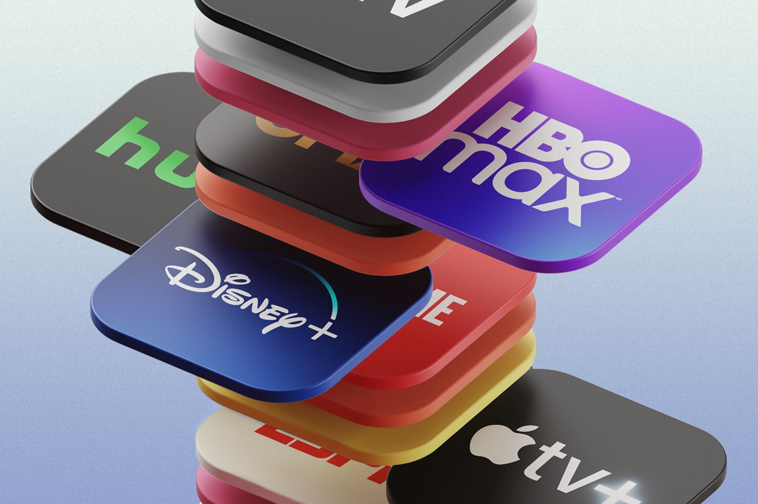
Why covid-19 and streaming services?
During the pandemic, watching shows and movies at home quickly became a popular form of entertainment.
It was one of the few ways we could relate and connect with people.
The lockdowns never slowed or stopped the streaming platforms, like it slowed almost all other forms of “outside” entertainment.
I wanted to know how they were really affected by the pandemic.

Slide 5
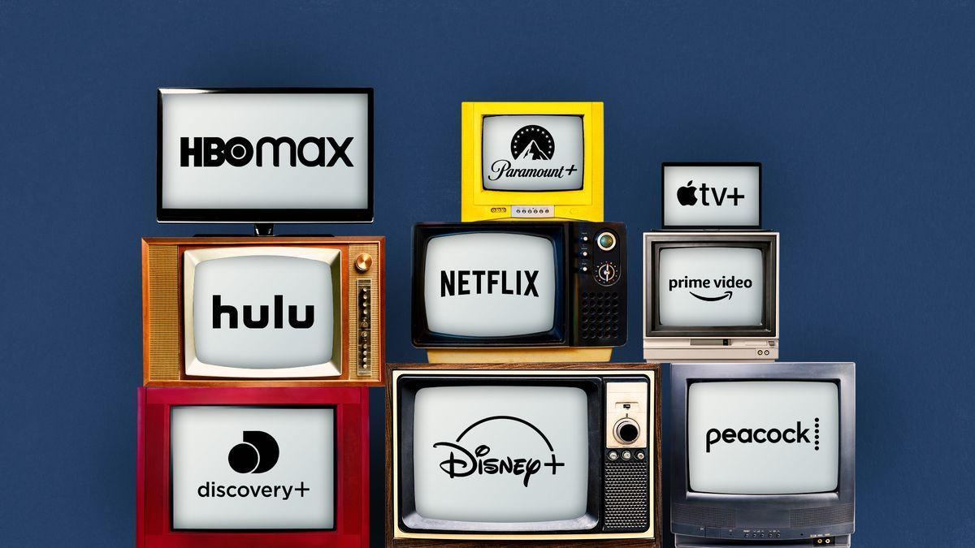
Why Netflix & Hulu?
In this presentation, the two companies being analyzed are Netflix and Hulu.
They are the most popular platforms that have been around 10+ years.
There is simply not enough public data for other popular platforms.
Some services like Disney+, HBO Max, and Peacock did not come out until the Pandemic.
Amazon Prime Video is not seen as a streaming service platform, it is a TVOD/SVOD (transactional video on demand, subscription video on demand).

Slide 6


In 2007, Netflix introduces streaming media and video on demand.
In 2010, Hulu became a streaming service.
Today, they are reaching nearly 220 million subscribers.
Today, they have nearly 45 million subscribers.
They have 11,300 employees as of 2021.
They have 725 employees as of 2021.

Slide 7
TABLE OF CONTENTS
01
02
03
genre
Revenue
Content
What were we watching?
How were their financials effected?
How much were they spending?
04
05
06
Subscription
Summary
Questions
How many people were watching?
So… what now?
Any questions?

Slide 8

01
genre
The pandemic changed what we watched.

Slide 9
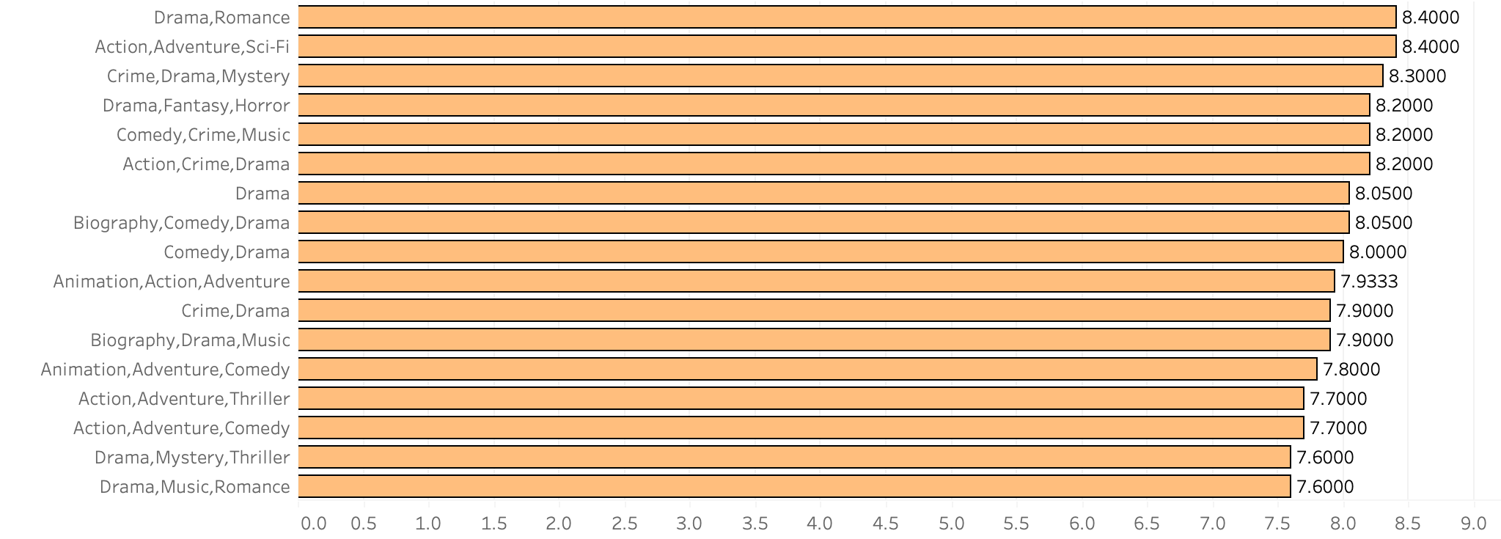
2018 IMDb Category tier list
1: Drama, romance
2: Action, Adventure, Sci-fi
3: Crime, Drama, Mystery

Slide 10
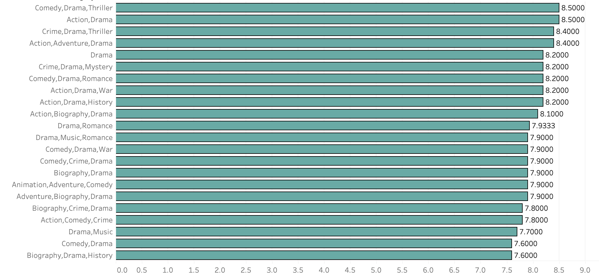
2019 IMDb Category tier list
1: Comedy, Drama, Thriller
2: Action, Drama
3: Crime, Drama, Thriller

Slide 11
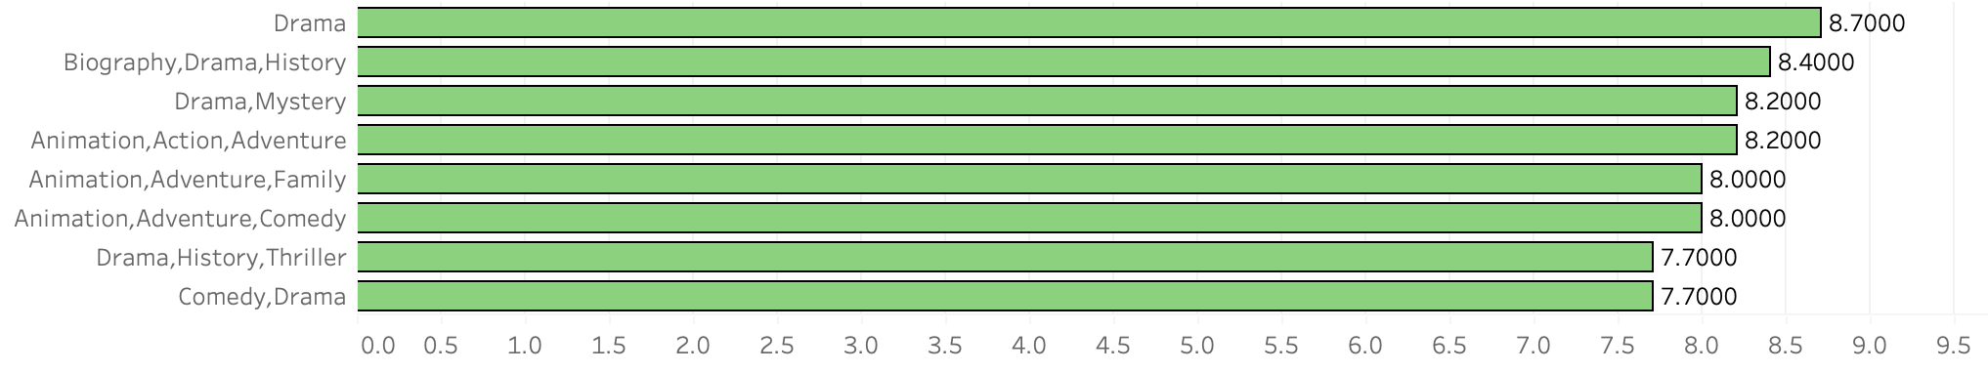
2020 IMDb Category tier list
1: Drama
2: biography, drama, history
3: drama, mystery

Slide 12
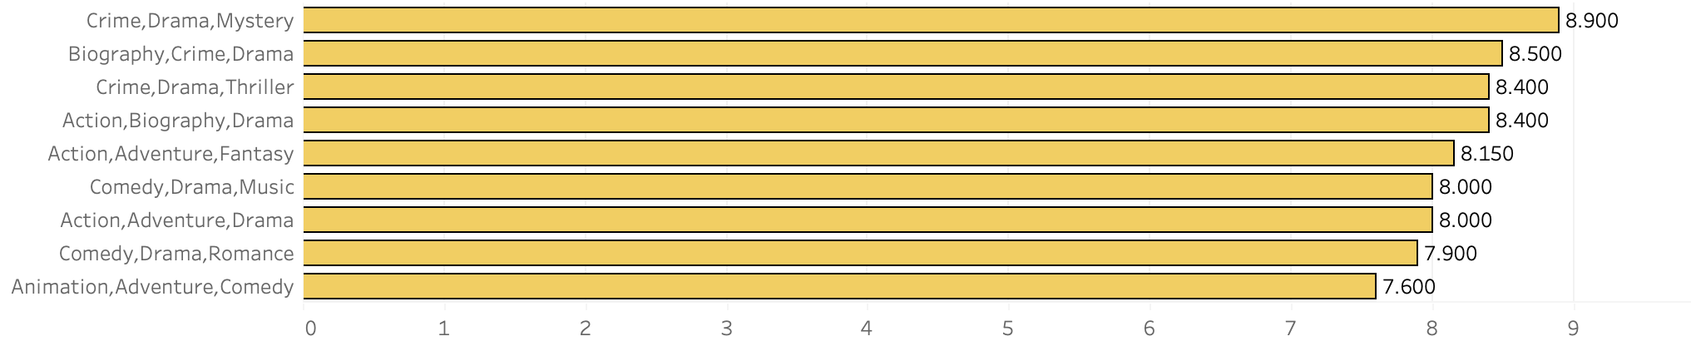
2021 IMDb Category tier list
1: crime, Drama, mystery
2: biography, crime, drama
3: crime, drama, thriller

Slide 13
01
2018
2019
2020
2021
drama is a consistent high ranking genre.
in 2020, Animation was also more popular than ever before.
In 2020, for the first time, biography and history ranked second.
the pandemic caused us to escape our reality through the reality of others.

Slide 14
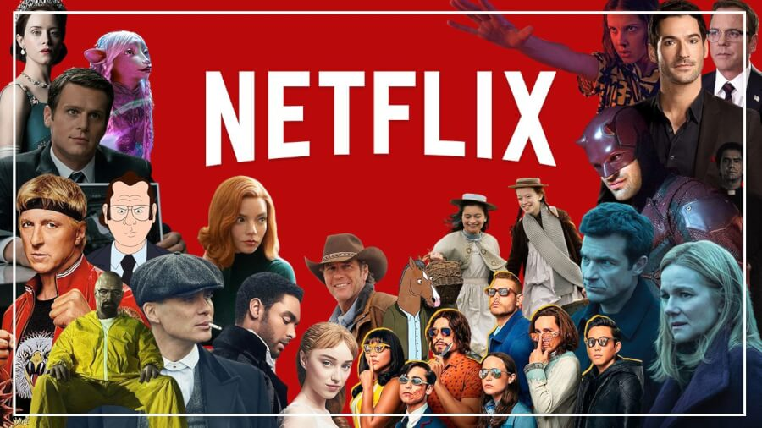
02
Revenue
The pandemic had an effect on companies financials.

Slide 15

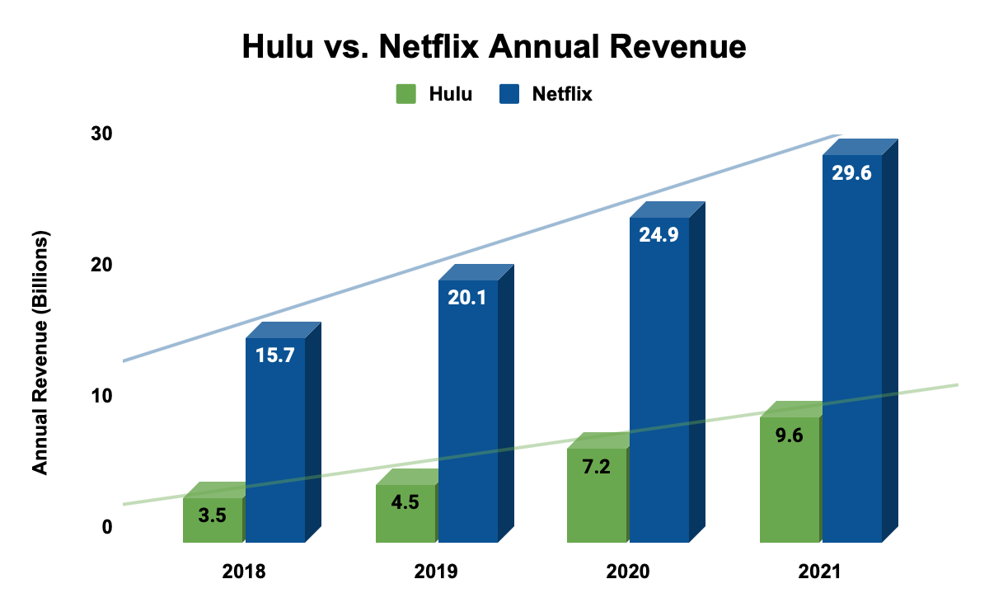
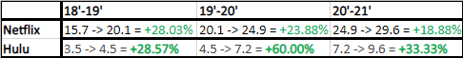
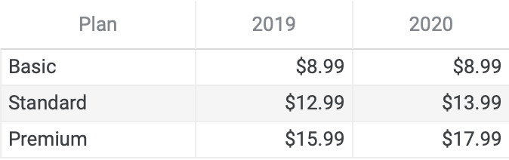
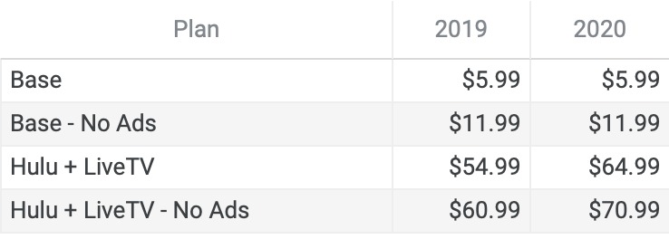
Annual revenue growth
Hulu had a 60% increase during the pandemic.
Netflix had steady $4 billion annual growth.

Slide 16
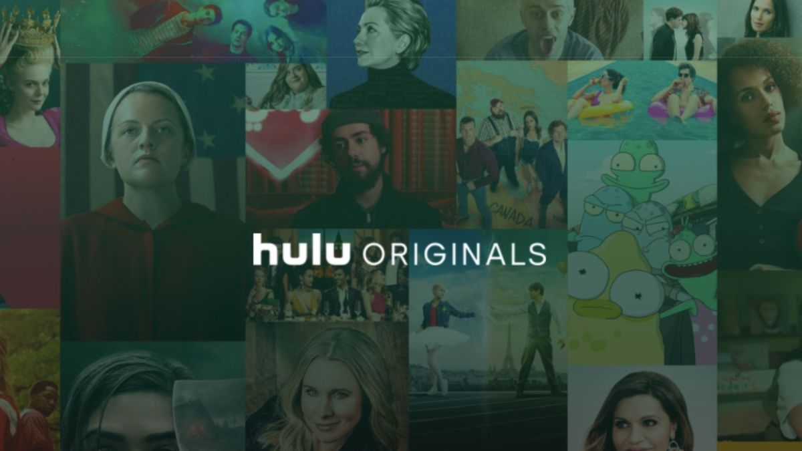
03
Content
Companies spent less but made more.

Slide 17

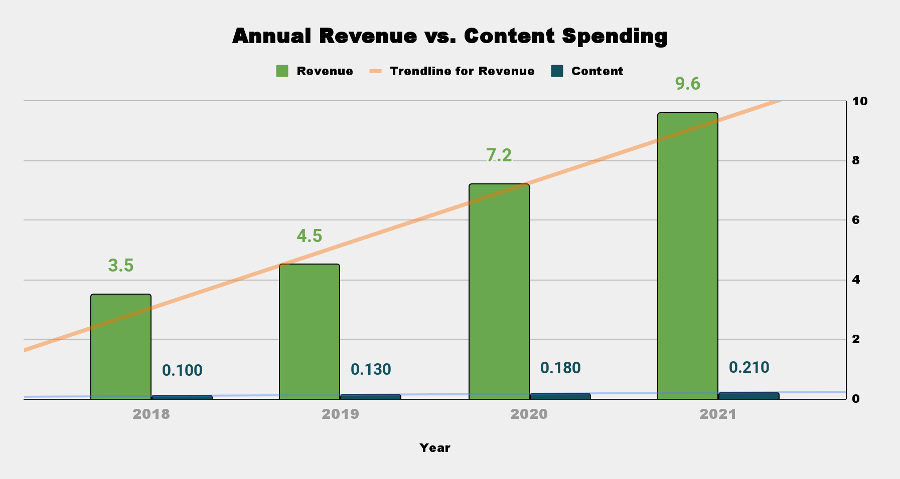
60%
$2.7b revenue increase
2019-2020
38%
$50m content spending increase
2019-2020
Pandemic Hits
$5.1b
$5.1b made in annual revenue
since pandemic
$80m
$80m spent on content
since pandemic
Pandemic effect
The pandemic created a wave of customers which ultimately created an immense growth in revenue, without having to spend much on product.
Annual Revenue - The amount of money made directly from consumers.
Content Spending - The amount of money spent on original content and acquisition of titles/sports.

Slide 18

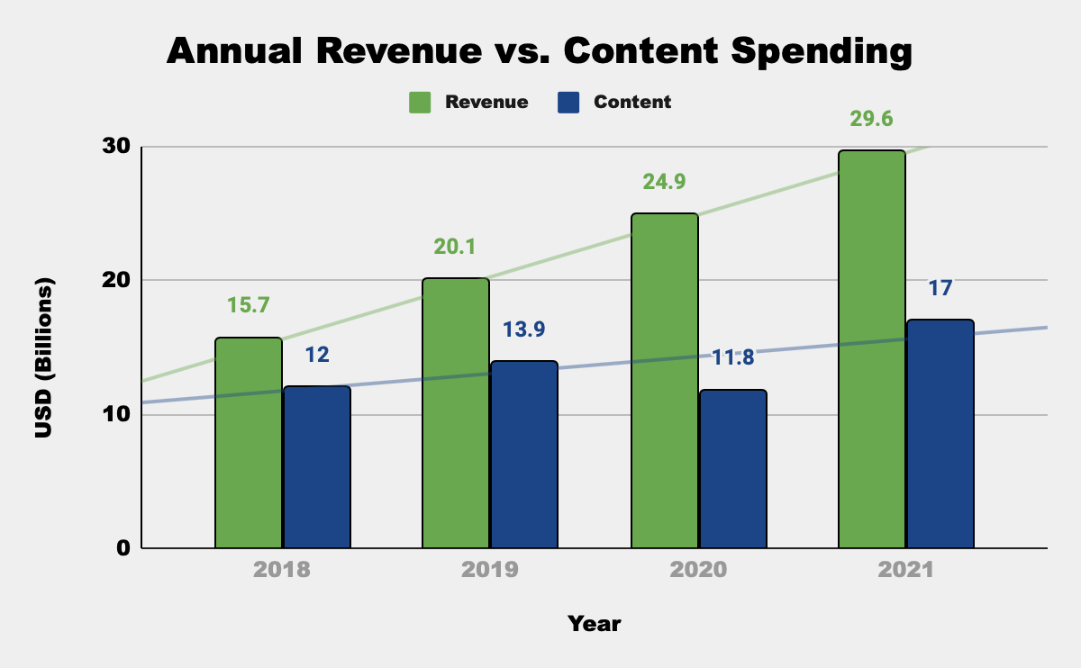
Pandemic Hits
$4b
Average annual increase of $4b
2018-2021
15%
15% decrease in content spending
2019-2020
x2
content/revenue gap doubled from $6.2b to $13.1b
2019-2020
44%
content spending increased by 44%
2020-2021
Pandemic effect
Is this a once in a lifetime anomaly or did the pandemic create a new trend of spending less and making more?

Slide 19
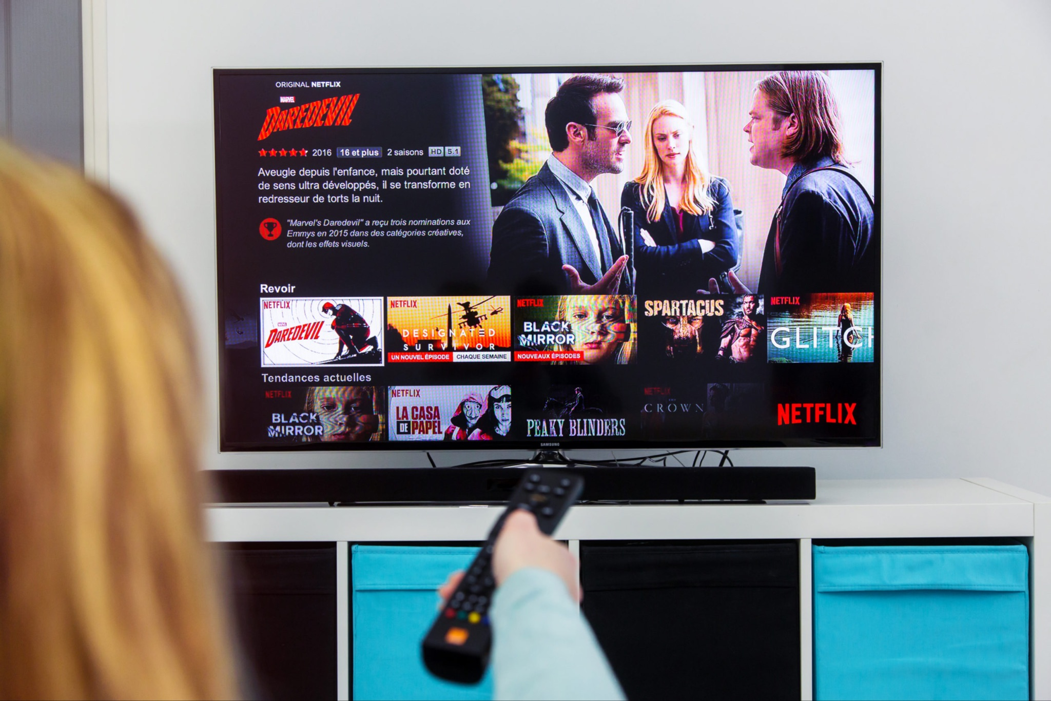
04
Subscriptions
How many people joined into streaming services?

Slide 20
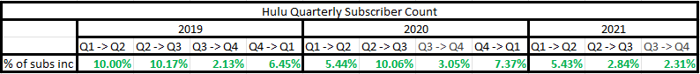
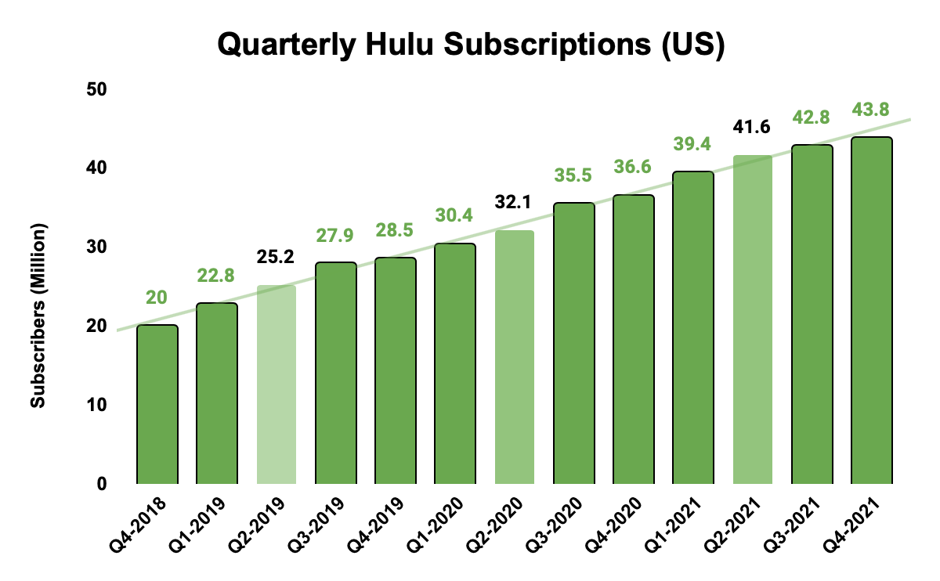
10%
10% increase during US first major lockdown
Q2 2020 - Q3 2020
27%
6.9 million subscriber increase
2019-2020
29%
9.5 million subscriber increase
$
2020-2021
$
Q4
Price raise in subscription plans
Q4 2019 & Q4 2020
Pandemic effect
The pandemic created more consumers, thus more subscriptions.

Slide 21
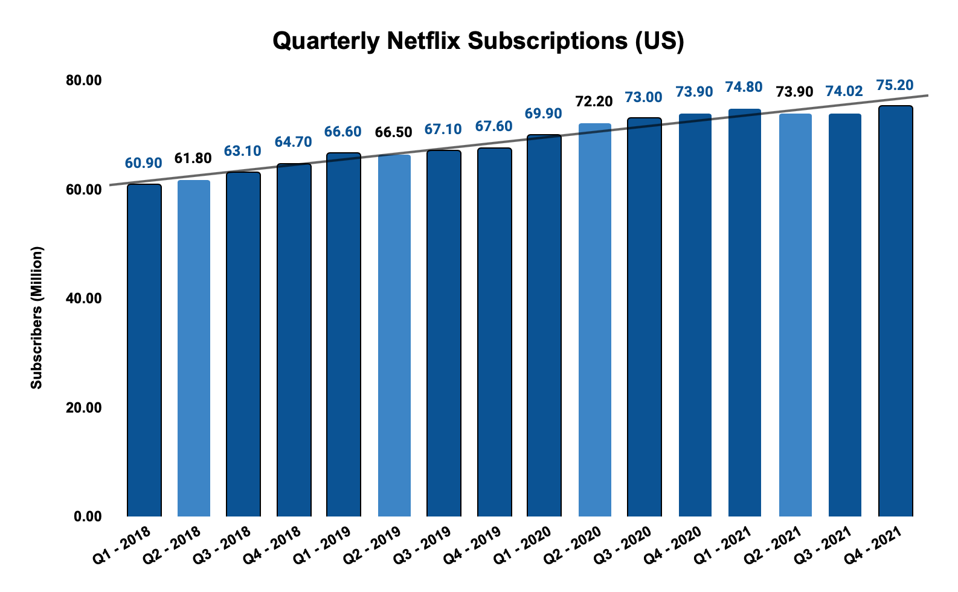
$
$
1%
only 1.10% subscriber growth
Q2 2020 - Q3 2020
-1%
1.21% decrease in subscribers
Q1 2021 - Q2 2021
8.5%
5.7m subscriber increase
2019-2020
2.3%
1.7m subscriber increase
2020-2021
Pandemic effect
Netflix did not see a drastic increase in subscribers during the pandemic. This could be do to account sharing.
The highest increase in subscribers was from 2019 going into 2020 with a 3.41% increase, while the second highest percentage was the next quarter with a 3.24% increase.

Slide 22
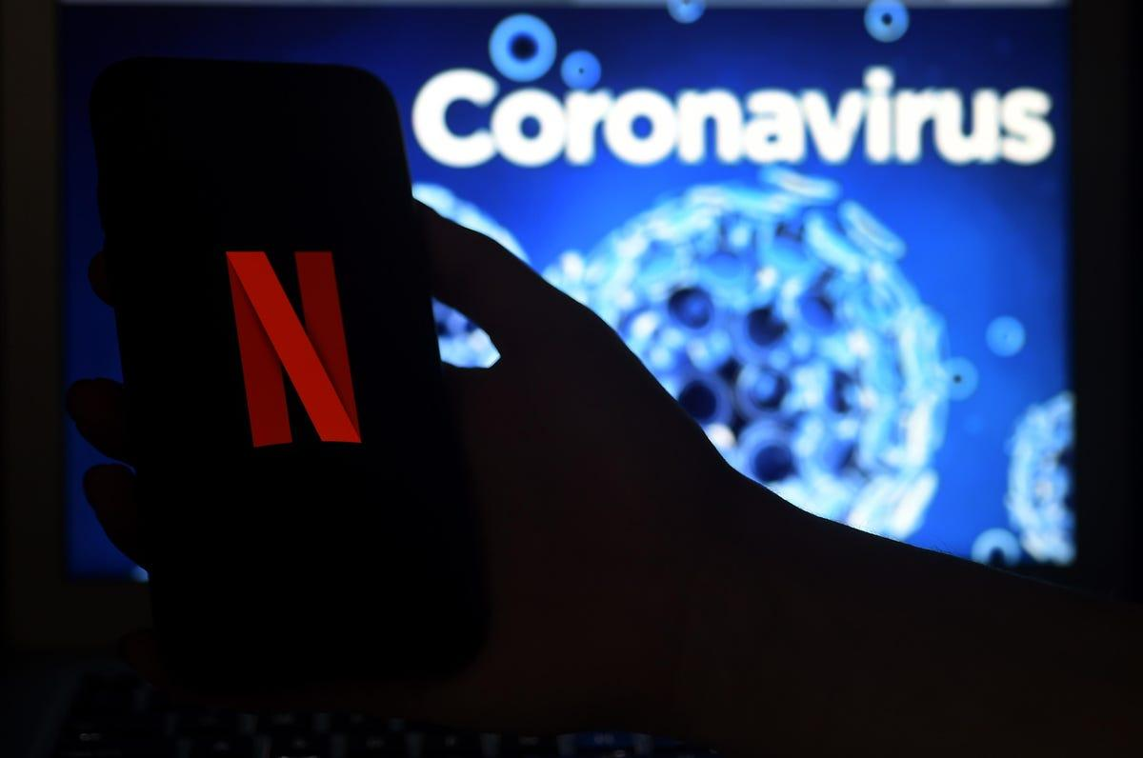
05
Summary
The pandemic affected the streaming service industry.

Slide 23
Pandemic effect
A new wave of streaming services customers
growing gap between content spending and revenue
biography, history and mystery became most popular
The living room was the new movie theatre experience. New subscribers brought in billions for entertainment services companies.
In the coming years, will we see a continuum of the growing gap between content costs and annual revenue?
Companies were not able to produce new content
We escaped our own reality through others realities while on quarantine/lockdown.
And they didn’t have to. They spent less than ever on content and still made billions.

Slide 24
QUESTIONS?

